Slide 1
Job Submission to HPC Cluster

Slide 2
Presentation Outlines
Introduction
Role of Resource manager and Job Scheduler
SLURM
Components
Commands
Job script
Job submission

Slide 3
Introduction
Cluster has a finite resource that is shared by many users.
In the process of getting work done, users compete for a cluster nodes, cores, memory, network, etc.
In order to fairly and efficiently utilize a cluster, a special software system is employed to manage how work is accomplished.
Systems to allocate shared compute resources to users of a large compute system
Workload is managed by a resource manager and a job scheduler

Slide 4
Terminology
Job- a reservation on the system to run commands
Node- physical machine that is part of the cluster. The cluster is made up of many connected nodes.
Core/CPU- processing unit for computing.
One node contains many cores or CPUs
Partition- where to run jobs, queue
Walltime - how long your job will run

Slide 5
Role of Resource Manager
Resource manager will make a parallel computer easy to use as PC
The “glue” for a parallel computer to execute parallel jobs
Allocate resource within a cluster
Nodes
Memory
Interconnect
Generic resources( like GPU)
Licenses
monitors node availability and load(usage)
manages CPU,network,disk,memory etc in a cluster

Slide 6
Role of Job Scheduler
When there is more work than resources, the job scheduler manages queues of work
Supports scheduling algorithms
Optimized for network topology, fair share scheduling, advanced reservations, preemption, time-slicing jobs etc.
sends compute tasks to nodes
manages queues and priority
Supports resource limits
Many batch system provide both resource management and job scheduling within a single software eg LSF, Torque and Moab job scheduler
SLURM fulfills both the resource manager and job scheduling functions

Slide 7
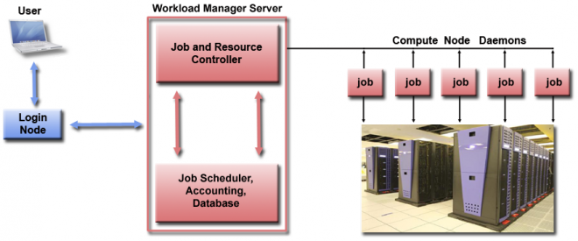

Slide 8
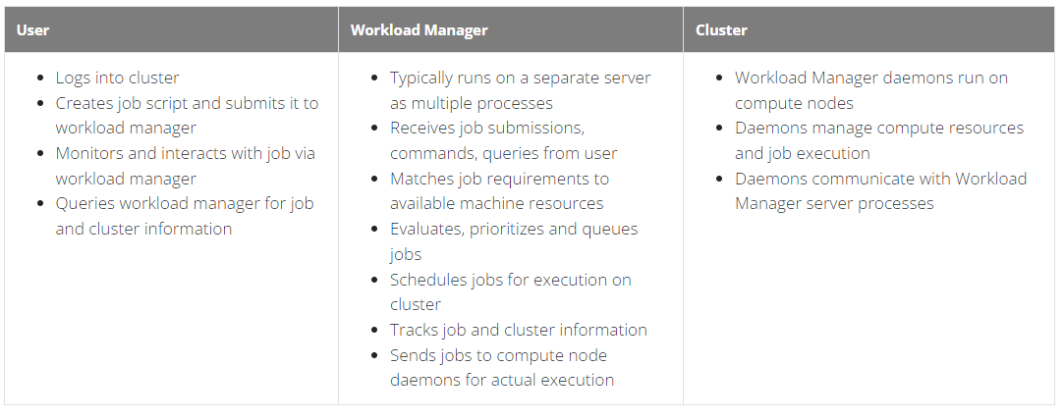

Slide 9
SLURM
Simple Linux Utility for Resource Management
Development started in 2002 at Lawrence Livermore National Laboratory as a simple resource manager for Linux clusters
Open source GPL license
Supports AIX, Linux, Solaris and other Unix variants
Used on many of the world’s largest computers
Slurm is the workload manager on about 60% of the TOP500 supercomputers.
Slurm uses a best fit algorithm based on Hilbert curve scheduling or fat tree network topology in order to optimize locality of task assignments on parallel computers.

Slide 10
Slurm Features
Advanced reservation
Idle nodes can be powered down
Scheduling for generic resources (e.g. Graphics processing unit)
Real-time accounting down to the task level (identify specific tasks with high CPU or memory usage)
Accounting for power consumption by job
Job profiling
No single point of failure, backup daemons, fault-tolerant job options
Highly scalable (schedules up to 100,000 independent jobs on the 100,000 sockets)
High performance (up to 1000 job submissions per second and 600 job executions per second)
Integrated with database for accounting and configuration
Resource allocations optimized for network topology and on-node topology
More info… https://slurm.schedmd.com/documentation.html

Slide 11
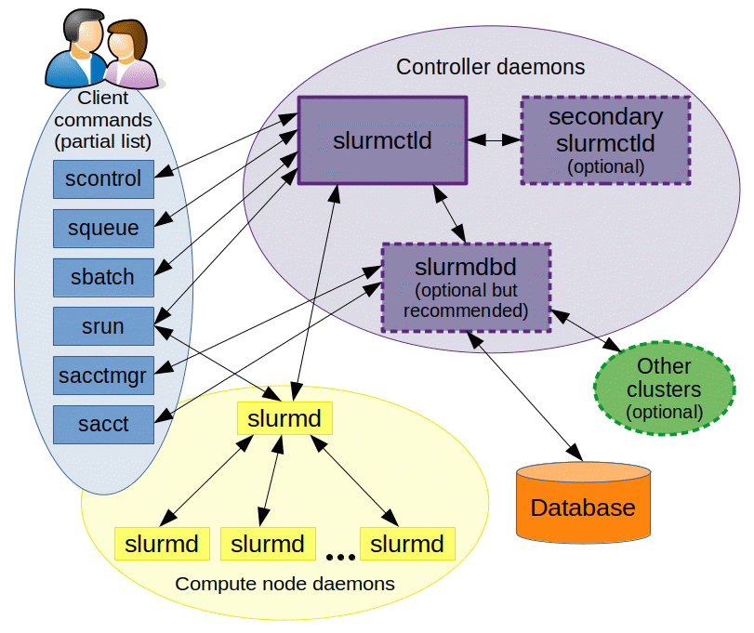
SLURM Components
Daemons
slurmctld – Central controller
Monitors state of resources
Manages job queues
Allocates resources
slurmdbd – Database daemon
Collects accounting information
Uploads configuration information to slurmctld

Slide 12
SLURM Components….
Daemons
slurmd – Compute node daemon
Launches and manages slurmstepd
Small and very light-weight
Dormant after launch except for optional accounting
slurmstepd – Job step shepherd
Launched for batch job and each job step
Launches user application tasks
Manages application I/O, signals, etc.

Slide 13
SLURM commands
Slurm Command Description
sbatch - Submit a job to the scheduler
srun - Submit and interactive job to the scheduler
scancel - delete a job already submitted
sinfo - to view Slurm partition and mode info
squeue - to view job information
General Information
man sbatch
man squeue
man sinfo
man scancel

Slide 14
SLURM commands…..
Submitting jobs
Prepare a job script file eg submit.sh
How to write a job script file
Once script is ready, then submit using
$ sbatch submit.sh
Once successful, returns a JobId
JobId can be used to view the submitted job information
Output and error information can be written in file

Slide 15
SLURM job script
The job flags are used with SBATCH command.
The syntax for the SLURM directive in a script is "#SBATCH <flag>"
Directives
—-------------
—------------
—------------
—------------
Commands
—--------------
—--------------
—--------------
—-------------

Slide 16
SLURM job script
The job flags are used with SBATCH command.
The syntax for the SLURM directive in a script is "#SBATCH <flag>"
Directives
#!/bin/bash
#SBATCH --nodes=1
#SBATCH --ntasks-per-node=1
#SBATH --time=00:10:00
Commands
srun hostname
srun sleep 60

Slide 17
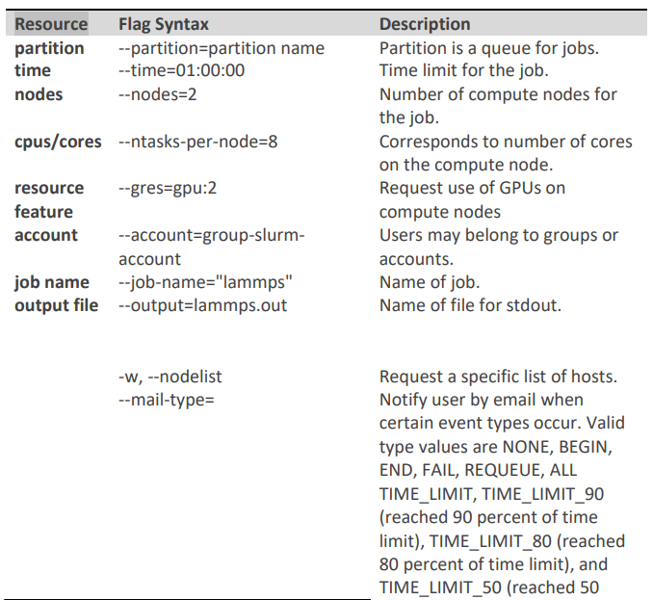
Parameters used in SLURM job script

Slide 18
Slurm Directive Example
To run a 32-core job for 24 hours on a single CPU node
#SBATCH --partition=standard
#SBATCH --nodes=1
#SBATCH --ntasks=32
#SBATCH --time=24:00:00

Slide 19
#!/bin/sh
#SBATCH -N 1 // specifies number of nodes
#SBATCH --ntasks-per-node=48 // specifies cores per node
#SBATCH --time=06:00:00 // specifies maximum duration of run
#SBATCH --job-name=myjob // specifies job name
#SBATCH --error=job_%J.err // specifies error file name
#SBATCH --output=job_%J.out //specifies output file name
#SBATCH --partition=standard // specifies queue name
cd $SLURM_SUBMIT_DIR // To run job in the directory from where submitted
export I_MPI_FABRICS=shm:dapl //For Intel MPI versions 2019
mpiexec.hydra -n $SLURM_NTASKS lammps.exe

Slide 20
SLURM commands….
Information on submitted jobs
List all current jobs for a user:
squeue -u <username>
List all running jobs for a user:
squeue -u <username> -t RUNNING
List all pending jobs for a user:
squeue -u <username> -t PENDING
List detailed information for a job (useful for troubleshooting):
scontrol show jobid -dd <jobid>
List status info for a currently running job:
sstat --format=AveCPU,AvePages,AveRSS,AveVMSize,JobID -j <jobid> --allsteps
Accounting information
sacct -u <username>

Slide 21
SLURM commands…..
Controlling jobs
To cancel one job:
scancel <jobid>
To cancel all the jobs for a user:
Scancel -u <username>
To cancel all the pending jobs for a user:
scancel -t PENDING -u <username>
To cancel one or more jobs by name:
scancel --name myJobName

Slide 22
SLURM commands….
Interactive job
srun - for the interactive jobs
srun -N 1 -n 1 -c 1 --mem=1gb -t 20 --pty bash
Here, it makes following request
1 node (-N 1)
1 core (-n 1 -c 1)
1gb of RAM (--mem=1gb)
20 mins of walltime(-t 20)
--pty bash tells the system that you want to run a bash shell(interactively)
when you see the prompt again, you are running a shell in a new interactive job allocation
type exit or it will exit after the end of walltime.

Slide 23
ThankYou!!

